Slide 1
Analysis on California Earthquakes from 1/1/1982 - 9/18/2019

Slide 2
Problem Statement
Analyze earthquakes and determine predictable, quantifiable patterns that reveal more information about earthquakes.
Determine if it is possible to predict future earthquakes
Use basis of patterns of previous earthquakes.
Observe quakes recorded at specific dates and times.
Observe magnitude of earthquakes and foreshocks/aftershocks.
Observe landscape where earthquakes typically occur

Slide 3
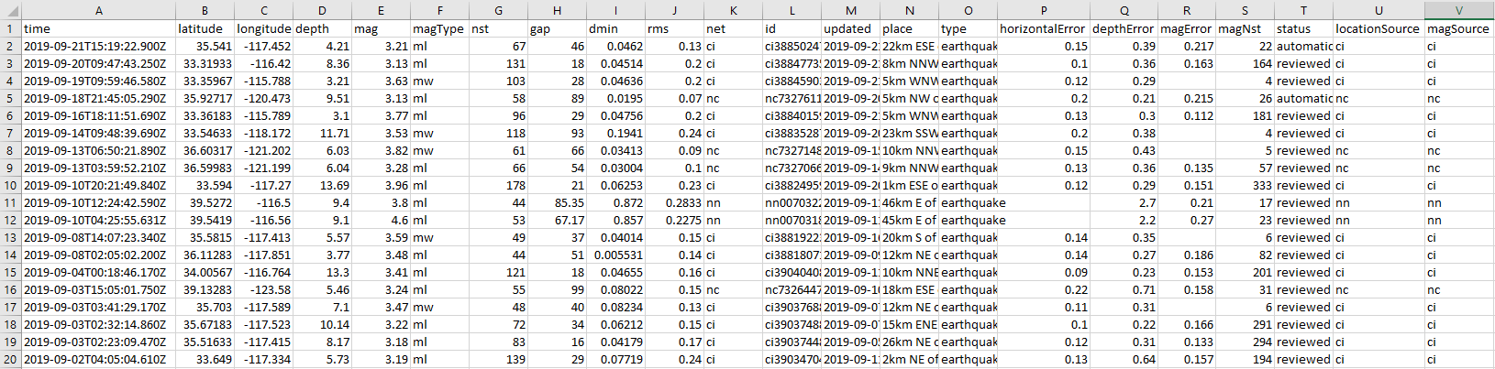
Data Set Description
The dataset chosen for this project contains earthquakes with a magnitude of 3.0 or above across California and part of Nevada from 1/1/1982-9/18/2019. It includes the exact location of the quakes in latitude and longitude coordinates as well as their magnitude, depth, and date of occurence. The dataset is 3.35 MB and contains 19,432 earthquake occurrences. There were also several other columns that contained information we did not use during this project, such as depth and magnitude error and earthquake id. The first 20 rows of the dataset are displayed below.

Slide 4

Data Set Origin
The dataset was taken from the United States Geological Survey (USGS), a scientific agency formed by the United States government to study the landscape, resources, and natural hazards of the United States. The USGS has published the earthquake data they have collected on their website. The user is able to specify the date range, geographic location, magnitude size, and file output format when downloading their earthquake data. However, a big drawback is they will only allow requests that are under 20,000 earthquake occurrences. Thus, we could only go as far back as 1982 to stay under the 20,000 limit, as we hit 19,432 earthquakes at that point. We additionally specified to keep earthquakes within the boundaries of California, exclude earthquakes below a 3.0 magnitude, and output the data via a .csv file for easy integration with Python Pandas.

Slide 5

Technologies Used
To analyze this dataset, we utilized a shared Google Colab notebook. This allowed for easy organization and collaboration, as each member was able to manage their own notebook cells, share the same dataset, and see and help out members with their work. Unfortunately, Google Colab was excessively slow for some operations, even with GPU acceleration enabled. Google Colab uses a single core Xeon Processor at 2.3 GHz, an NVIDIA Tesla K80 GPU for hardware acceleration, and 12 GB of RAM. Running parts of the code on the fastest local machine our team resulted in a 10x increase in speed for some graphs. The fastest machine we have uses an 8-core Xeon Processor at 2.8 GHz, no hardware acceleration, and 32 GB of RAM. The lack of speed displayed by Google Colab could be due to its nature as a free, remote machine. Thus, to develop parts of the code, we relied on locally developing the code, only uploading it to Google Colab to share our work with our team. Besides Google Colab, additional software dependencies included Python 3.7, Pandas, NumPy, Matplotlib, and Cartopy.

Slide 6
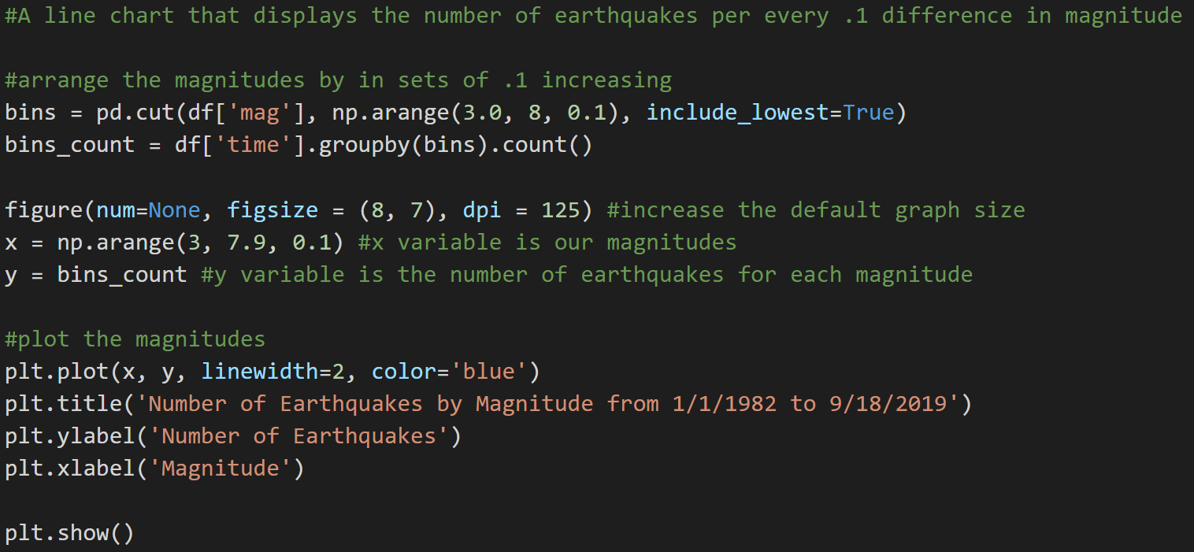
Number of Earthquakes by Magnitude
For our first graph, we plotted the number of earthquakes by magnitude. We first sorted the earthquakes into equally spaced bins according to their magnitude. The bins were all 0.1 magnitude apart, meaning we had a bin for 3.0-3.1 quakes, 3.1-3.2, and so on. We then plotted the number of earthquakes in each bin against their magnitude range.

Slide 7
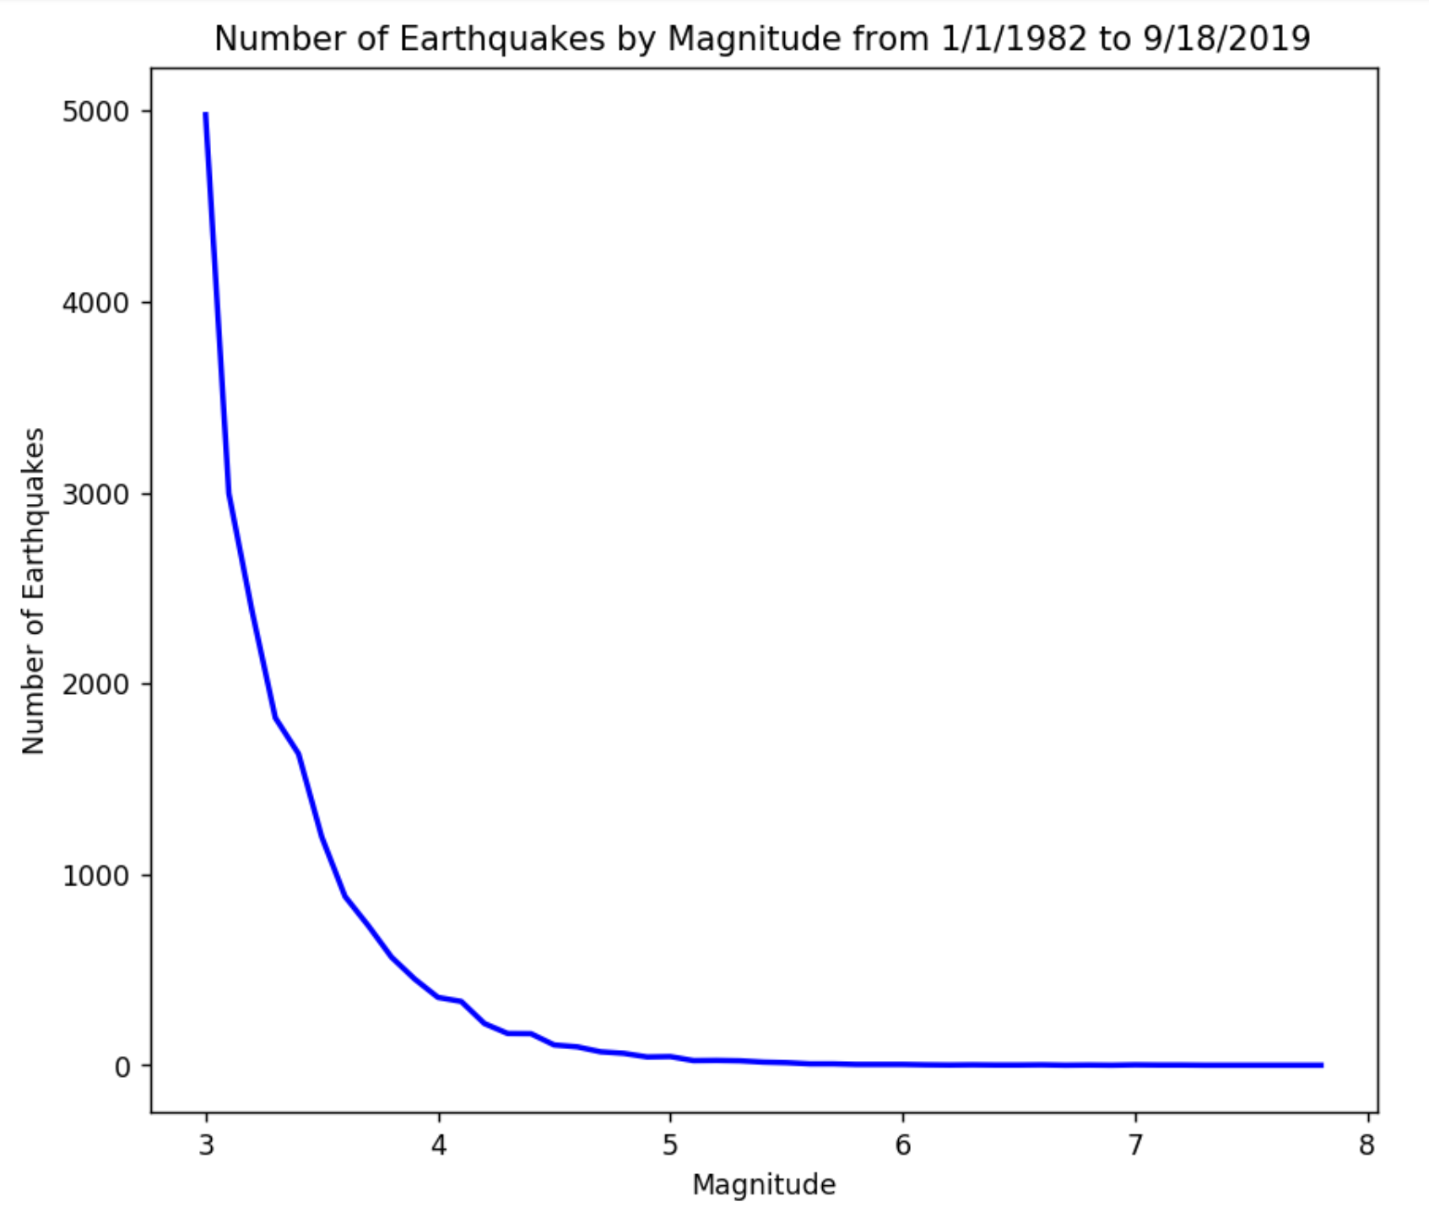
Number of Earthquakes by Magnitude
This resulted in this graph. As can be seen, the graph is exponential and almost entirely smooth. Many more earthquakes of smaller magnitude occur than those of higher magnitude. To obtain the exact function of this line, we used two different fitting methods: polynomial and logarithmic.

Slide 8
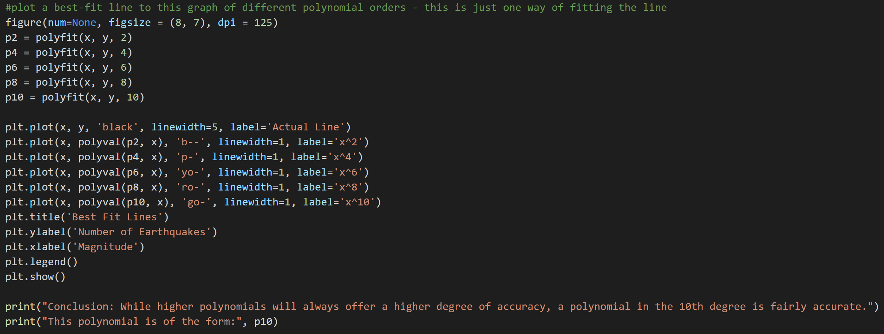
Polynomial Fitting
To fit our graph using a polynomial, we used Numpy’s polyfit and polyval modules. We specified the polynomial order in increasing sets of 2 up to 10, color-coded the lines, and graphed the estimated lines against the actual line.

Slide 9
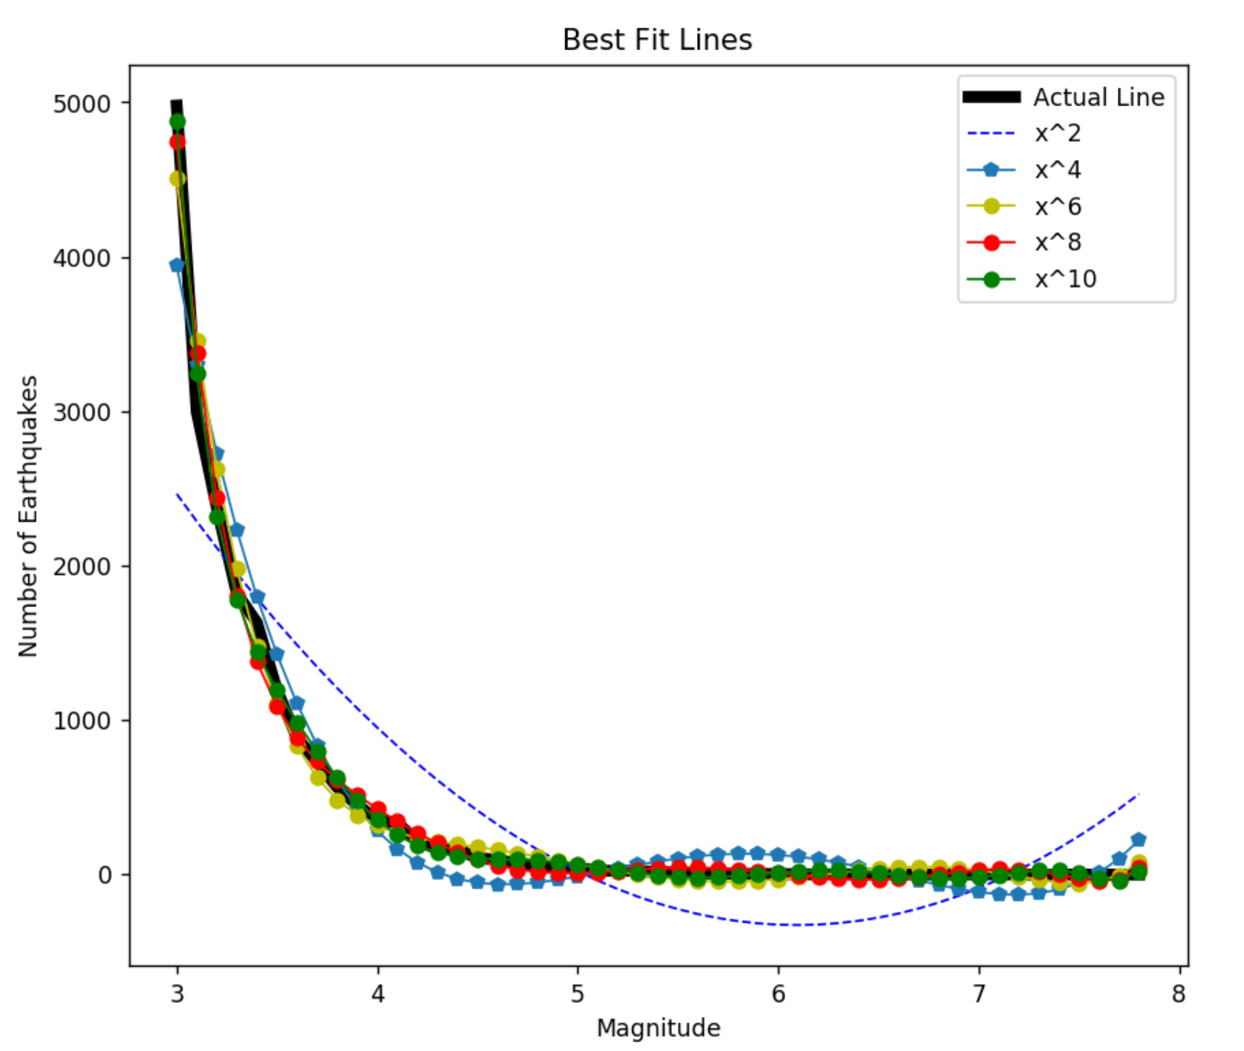
Polynomial Fitting
The graph reveals that a polynomial in the order of 10 is closest to our line. While increasing the polynomial degree will always result in a more accurate line, it could lead to overfitting, something the polyfit module will warn about after going over an order 10 polynomial. Getting the equation of this line is difficult; there is no built-in function for this in Numpy or Matplotlib. The points plotted are (x, polyval(p10, x)), where x is an array of magnitude ranges (3.0-7.8) and polyval returns an array with y values according to the number of earthquakes. There is a much easier way to get an equation of the line though, and a much simpler relationship that can observed from this graph - it is a semilogarithmic function.

Slide 10
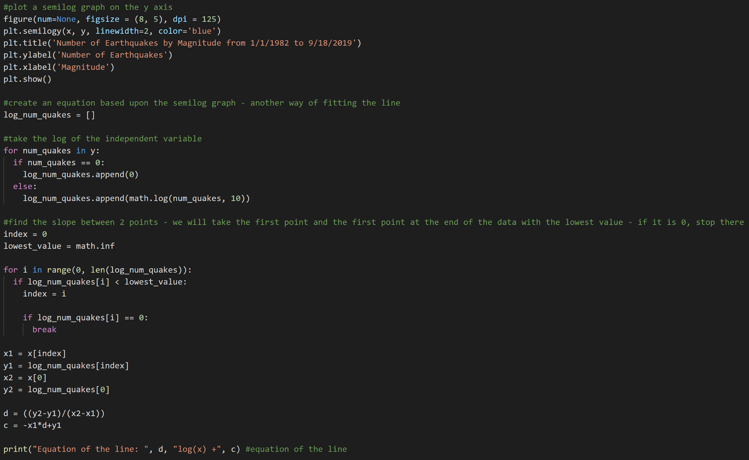
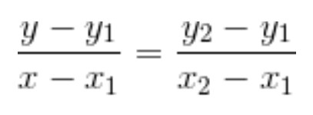
Logarithmic Fitting
Here, we graph the exact same function as before, x and y, but instead make the y axis logarithmic. We know that the x values are evenly spaced because we created them to be 0.1 apart from each other, but the y values may be logarithmic. If the graph has a logarithmic relationship, the result will be a straight line. We additionally create an equation of the line using a logarithm. By taking the log₁₀ of the independent variable, the number of earthquakes, we can use the point-slope formula on the left, replacing x with log₁₀(x), to create an equation of the line.

Slide 11
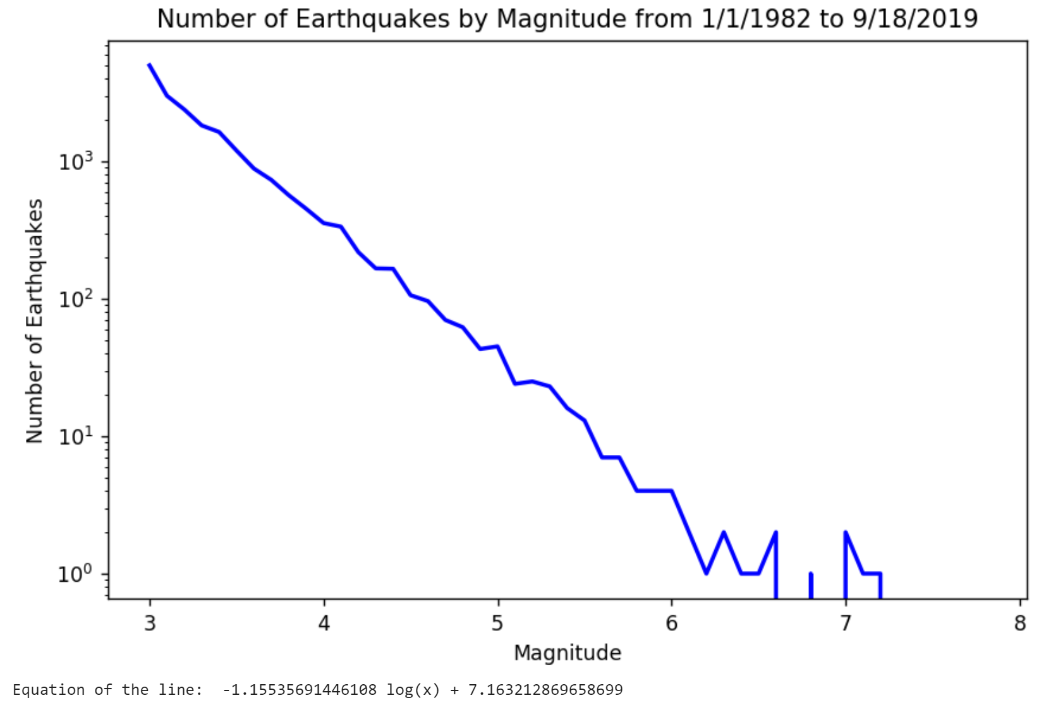
Logarithmic Fitting
The semilog graph is displayed to the right. As can be seen, the graph y-axis scale is logarithmic, and the graph is nearly a straight line. The frequency of earthquakes therefore has a logarithmic relationship, one that can be described by the following equation:
y = -1.15 log(x) + 7.16
where x is the number of earthquakes and y is the magnitude. This equation is based on a 37 year period from 1982 to 2019, so assuming earthquakes occur regularly throughout the century, it will give the probability of earthquakes in the next 37 years.

Slide 12
Logarithm Analysis
y = -1.15 log(x) + 7.16
Using the above equation, plugging in 5000 for x gives 2.9 for y, which is reasonable. About 5,000 earthquakes during our time period occurred with a magnitude of 2.9. Plugging in 5 for x gives 6.35, which is also reasonable. There were very few earthquakes with a 6.35 magnitude during our time period. However, this equation is not terribly useful. Rather than inputting the number of quakes, what if we wanted to input a magnitude and see the number of earthquakes that would occur over the next 37 years of that magnitude? To answer this question, we must rearrange our equation.

Slide 13
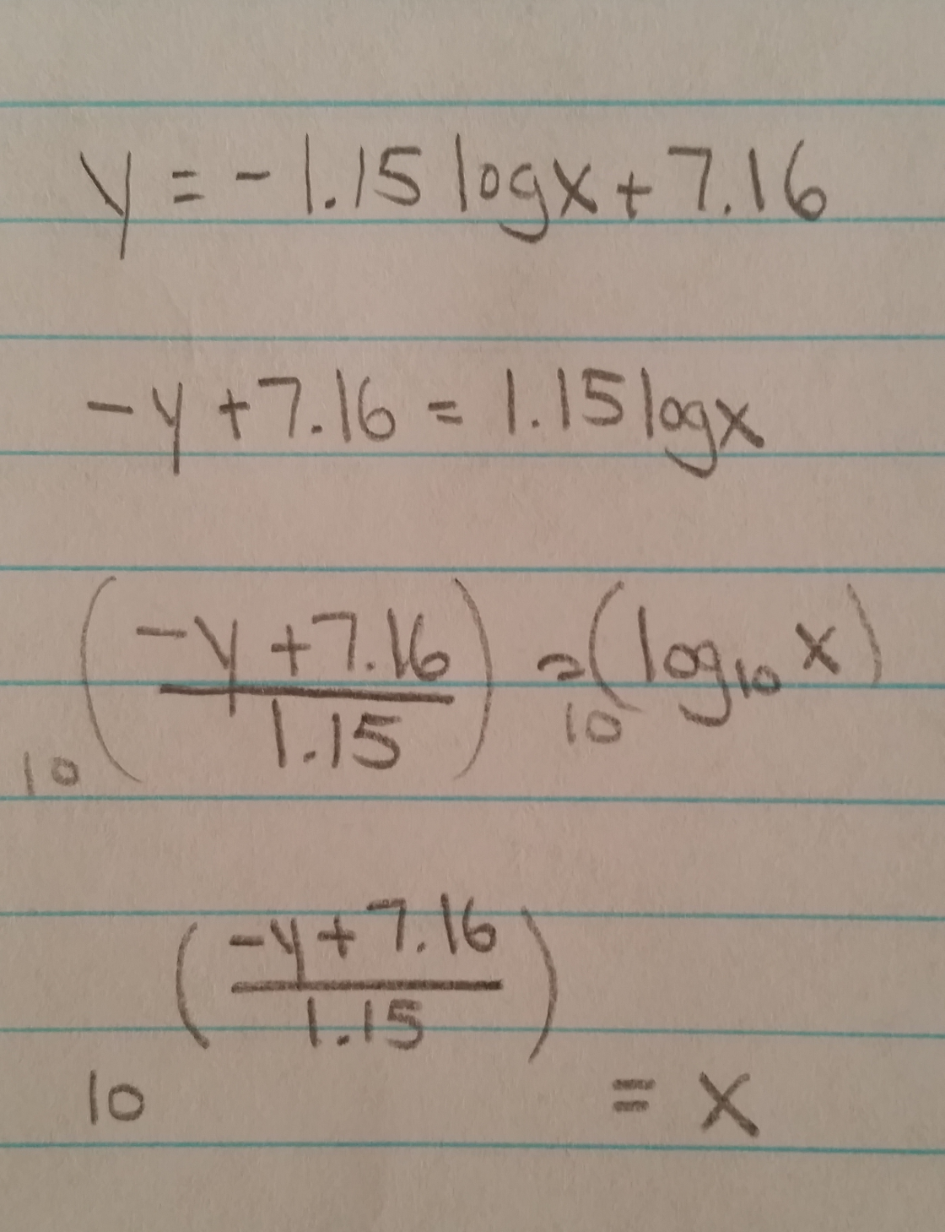
Logarithm Analysis
Using some algebra, we can rearrange our equation as shown to the right. Now, if we plug in 2.9 for y, we get out 4,897. In a period of 37 years, we are predicting that 4,897 2.9 magnitude earthquakes will occur. What are the chances of a bad earthquake, like a 7.0? 1.38. Thus, an average of only one 7.0 will occur in California over the next 37 years. How many years will it take before the next 8.0 earthquake? Plugging in an 8.0 gives 0.188, which are the chances of an 8.0 occuring with the next 37 years. Then take 1/0.188 = 5.3 and multiply by 37, the number of years for each 0.188 quake. This gives 196. Thus, our data suggests that an 8.0 quake will occur in California every 196 years.

Slide 14
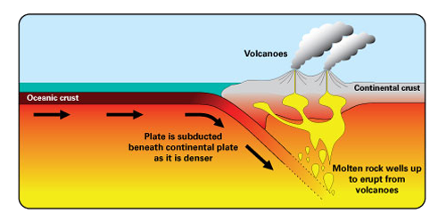
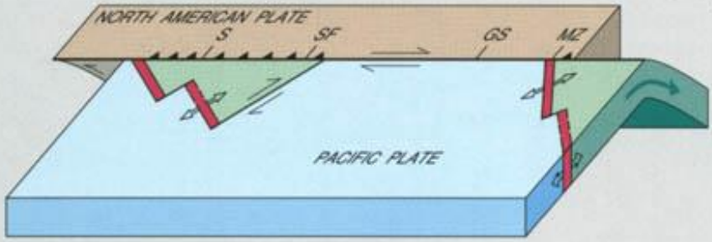
Why Earthquakes Occur
Before looking at the next graph, it is useful to first learn what causes earthquakes to happen, as it will help explain our results. As the oceanic crust converges towards the continental crust, the oceanic crust at a density of 3.0 g/cm³ is denser than the continental crust, which has a density of 2.7 g/cm³, and subducts under it. This results in an increase of pressure beneath the land, which forces the continental crust up, forming mountains and volcanoes as the pressure and heat seeks release. In regard to California, this is the meeting of the Pacific Plate and the North American Plate. Oftentimes the collision and movement of these tectonic plates as they move alongside each other causes a sudden release of pressure, causing seismic waves above that make the ground shake - an earthquake. We should thus expect to see the majority of earthquakes occur along mountains ranges and volcanoes.

Slide 15
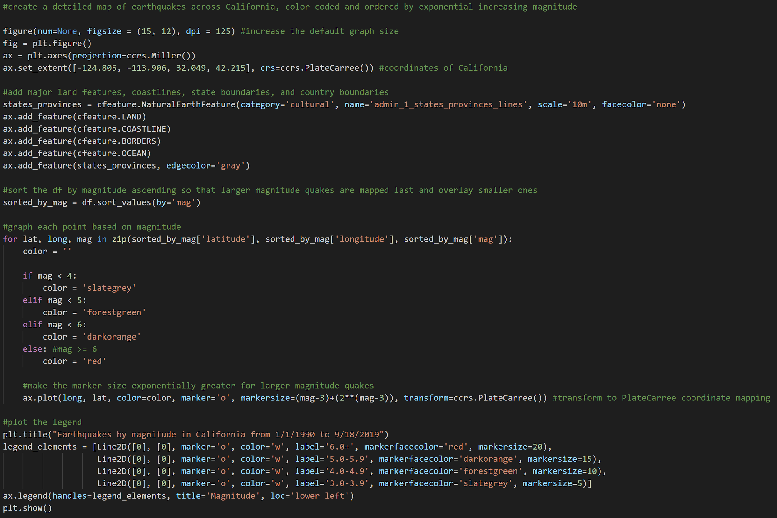
Earthquakes by Location and Magnitude
For the next graph, we plotted all the earthquakes in our dataset across California and Nevada, color-coded by magnitude range. Additionally, we made the marker size exponentially larger for larger earthquakes, according to the equation of (magnitude-3)+(2^{magnitude-3}). We then rendered a legend for the map. The code for this is displayed to the right.

Slide 16
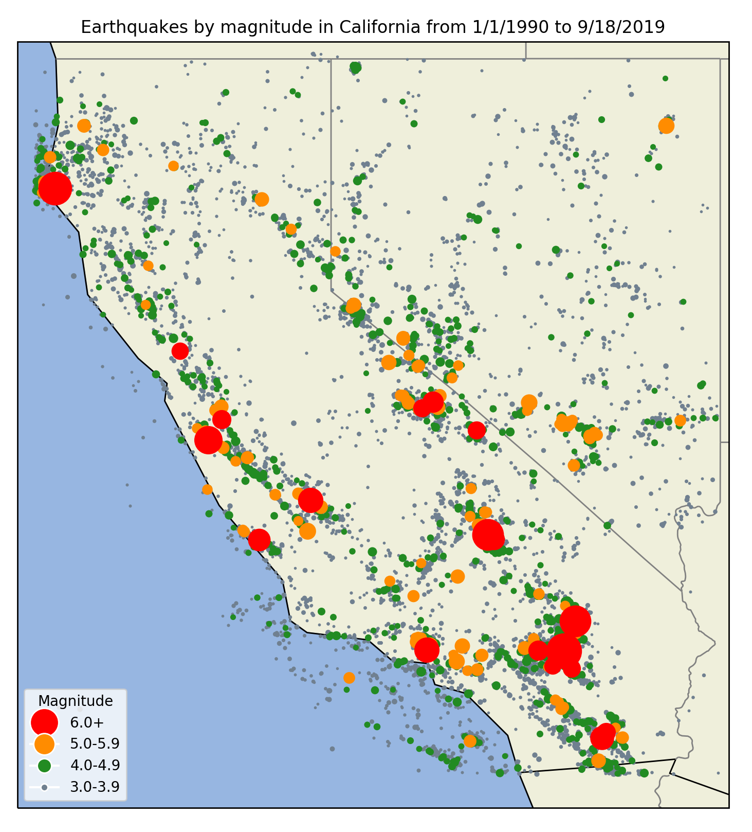
Result and Analysis
As can be seen from the graph on the right, smaller earthquakes are very common and large earthquakes are few, but tend to cluster together.
The largest cluster of large earthquakes can be seen just east of LA near Joshua Tree. Most earthquakes occur along the mountainous coastal ranges, with several occurring off the coast of southern California.
Interestingly, the Central Valley is almost devoid of earthquakes. This is because the Central Valley is flat and far from mountains on all sides, with little shifting of the tectonic plates beneath it and therefore earthquakes. The same is true of the Mojave Desert.

Slide 17
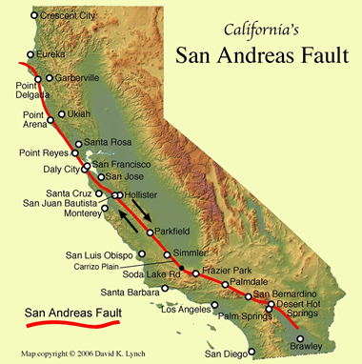
Fault Lines
Our graph also helps reveal fault lines - we can see the San Andreas fault line begin in Humboldt County and travel southeast towards LA, then cut inland and end at Joshua Tree. The San Andreas fault is displayed next to our graph, which shows how the majority of earthquakes occur over this fault line. The map on the left additionally shows elevation, and we can see that most earthquakes occur in mountainous regions.

Slide 18
Fault Lines
Superimposing the San Andreas fault over our graph shows how earthquakes follow the line. There are additional fault lines not shown, namely on the northern border of the Central Valley along the Sierra Nevadas. It can be seen that there is another fault line along the border of eastern California. By plotting earthquakes, we are able to see where earthquakes are more likely to occur and where the highest danger zones lie. This is invaluable information for individuals and businesses. It can help people decide if earthquake insurance is worth it, what standards to construct buildings under to ensure they are earthquake resistant, and where to avoid placing major buildings and machinery such as skyscrapers and nuclear facilities.

Slide 19
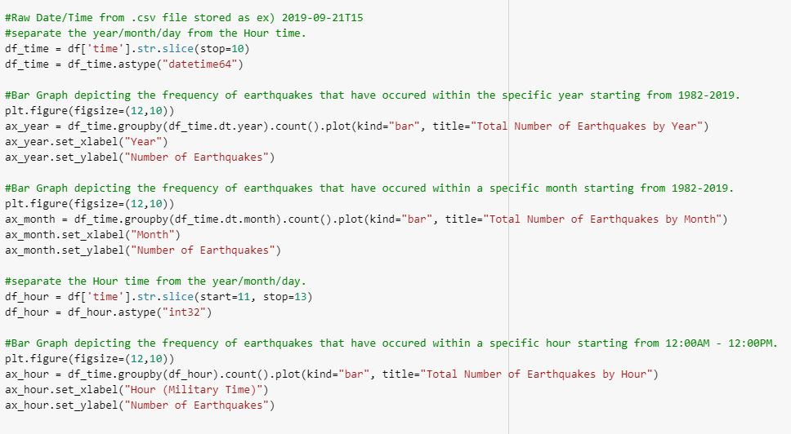
Earthquakes by Date and Time
With the given time data set, we then graphed the frequency of earthquakes at a certain date and time.
A bar graph was used to visualize the number of earthquakes recorded in a given Year, Month, and Hour.
By visualizing these three graphs, it gave us insight in attempting to see if there was a pattern in the occurrence of earthquakes.

Slide 20
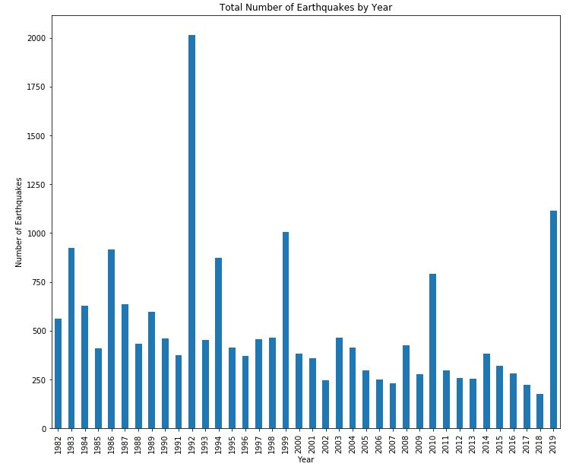
Earthquakes by Specific Year
A surprising finding was that 1992 had the most number of recorded earthquakes, being approximately double the number of earthquakes compared to any other year.
After research into why 1992 had so many earthquakes, 1992 was when three huge earthquakes took place within that year.
6.1 magnitude at Joshua Tree on April.
6.5 magnitude at Big Bear 3 hours after Joshua Tree.
7.3 magnitude at Mojave Desert on June.
These high magnitude earthquakes led to hundreds of aftershocks within the year of 1992.

Slide 21
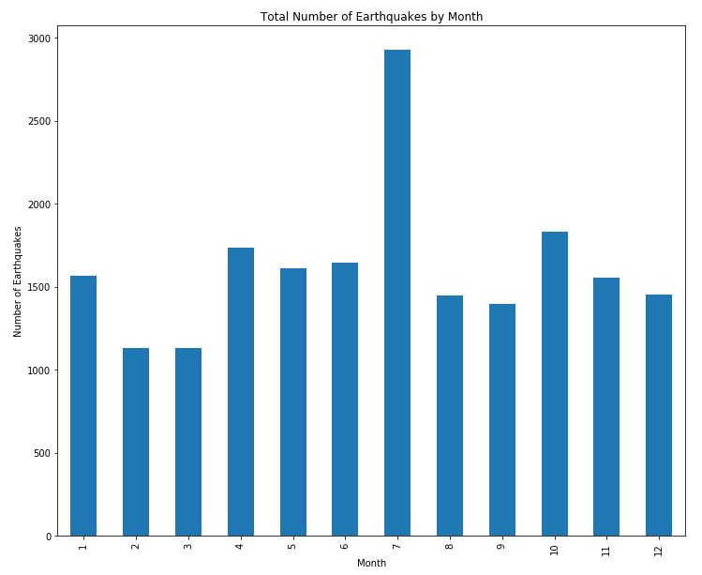
Earthquakes by Specific Month
Another interesting finding after graphing the number of earthquakes is that the month of July had the most recorded earthquakes.
There does not seem to be any research or studies on why July specifically might have the most number of earthquakes out of all the months, but after considering the analysis in the previous graph of 1992 having the most number of earthquakes, the many earthquakes from 1992 may have contributed to the high volume of earthquakes in July.

Slide 22
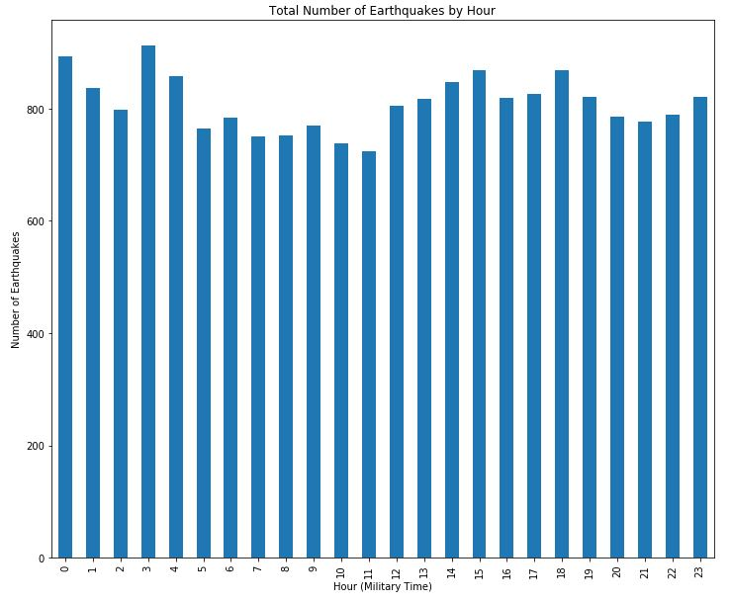
Earthquakes by Specific Hour
In terms of the time of day, there was no significant outlying data from the graph.
As far as earthquakes occurring within a specific hour, there does not seem to be a set pattern.
There was also no research evidence and study for time of day having an effect on seismic activity.

Slide 23
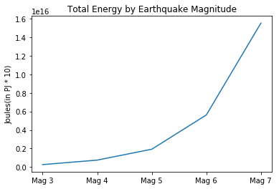
Energy Released by Earthquakes
Ranges from 3.0 - 7.9 earthquakes
The difference between major numbers in earthquakes, such as the differences between the a 2.0 and 3.0 earthquake is roughly 33x.
This difference can be seen in the amount of energy, which can be calculated from the magnitude with the formula: LogE = 5.24+1.44M
Despite there being 16,345 Mag 3.x earthquakes and 4 Mag 7.x earthquakes, 7’s produced more energy

Slide 24
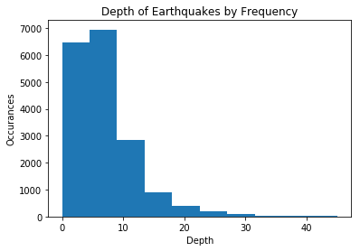
Earthquake Depth Frequency
The graph on the right is a histogram showing the frequency of earthquakes at the respective depths.
The Y-axis is a count of instances of an earthquake at that depth, whereas the X-axis is the depth at which that quake occurred.
As is evidence by the Graph, most quakes occur at a depth of 0-10, with a small subset being 10-20 and even less deeper than that.

Slide 25
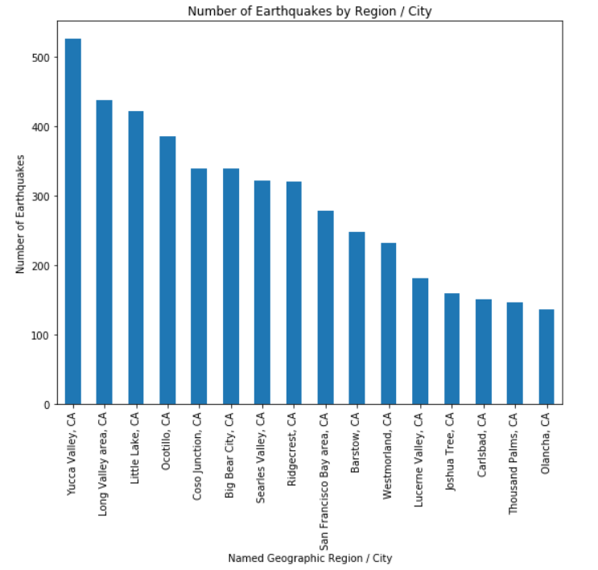
Earthquake Frequency By Region/City
USGS utilizes a GeoNames dataset to reference populated places that are close proximity to a seismic event.
The graph displays the top 15 regions/cities with the most occurrences of earthquakes.
Majority of the listed regions are in San Bernardino County (Yucca Valley, Searles Valley, Barstow, Lucerne Valley, Joshua Tree, Big Bear City) or Inyo County (Little Lake, Coso Junction, Olancha), which are near the end of the San Andreas Fault Line.

Slide 26
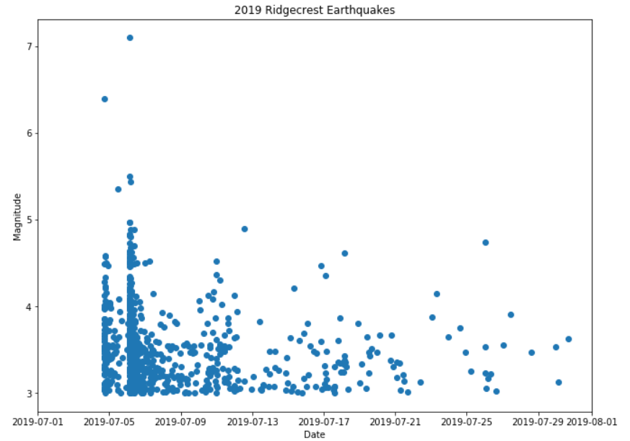
Aftershocks and Foreshocks
The 2019 Ridgecrest Earthquakes provide good examples of aftershocks and foreshocks.
The graph displays the 3 major shocks (6.4, 5.4, and 7.1) at the top of the graph between July 4th and 5th.
The first 6.4 earthquake is considered the foreshock, and the 7.1 earthquake is the mainshock.
The remaining 890 earthquakes below the 3 major shocks are the aftershocks.
Aftershocks can continue over period of hours, days, weeks, months, or even years.

Slide 27
Conclusions
To summarize the discoveries and analysis our team performed, we have made the following conclusions on earthquakes in California:
The number and magnitude of earthquakes in California over a period of 37 years can be defined by this function: y = -1.15 log(x) + 7.16.
An 8.0 earthquake will occur in California every 196 years.
Earthquakes are more likely to occur where they already have.
Earthquakes follow major fault lines which can be discovered by plotting all earthquakes over a period of many years.
Earthquakes mainly originate in mountainous regions.
Earthquakes, especially ones in high magnitude, can cause numerous aftershocks.
There does not seem to be any specific month or time of day where earthquakes are more likely to occur. As of now, it is not possible to predict an upcoming earthquake, but, as mentioned, it is possible to expect earthquakes to occur again in already shook regions.

Slide 28
Data Inaccuracies
The conclusions presented here are not entirely accurate. While modern earthquake detection mechanisms are very advanced, they still miss earthquakes every year, especially smaller ones. Additionally, man-made earthquakes are on the rise, some of which may have ended up in our data. This is caused by artificial lakes increasing weight on faults and fractures, waste being disposed of in underground wells, mining and mines collapsing, groundwater extraction, hydraulic fracturing, and fossil fuel extraction. Some of these events may have ended up in our data. Our data is also fairly limited, as 37 years of earthquakes will not produce relationships that would be as clear as analyzing 200 years worth of earthquakes. The issue with going back further is not only that the USGS limits data collecting to 20,000 results, but also that automatic earthquake detection and logging procedures did not exist 200 years ago, which would greatly skew our results. Finally, some rounding was used to reduce complex equations, such as the logarithmic equation that represents the number of earthquakes by magnitude.

Slide 29
Final Note on Google Colab
While Google Colab is convenient in offering a shared work environment and a highly organized structure with separated cells, it was made difficult to use by lack of ability to easily install necessary dependencies. While dependencies can be installed through commands run through the notebook, they must be reinstalled each time the notebook is closed and reopened. A local machine does not have this drawback. Additionally, Google Colab does not work nicely with Cartopy, a Python package designed for geospatial data processing in order to produce maps. When Cartopy is installed, it downloads several world map files on your system in order to recall these from secondary storage and instantiate them on a map when the corresponding code is called. For some reason, Google Colab dumps this information. The result is that even though Cartopy is properly installed, it is missing several dependencies in order to draw nicer backgrounds for the maps.

